Slide 1
Group 1
Customer Segmentation
Soumyadip Koner
Pratheep knadar
Parag Khodpe
Neha Pal
Ashish Katkar
Rushikesh Dhole

Slide 2
About the Dataset This is a marketing data set which contains data of the customers belonging to company. This data set has 2240 rows and 28 columns. Since this is a marketing data set, we can categorize the variables in terms of the 4 P's of marketing: products, people (customers), places (channels), and promotions (discounts & campaigns). The variables are as follows:ID: Customer&#39;s unique identifier
People
Year_Birth: Customer&#39;s birth year
Education: Customer&#39;s education level
Marital_Status: Customer&#39;s marital status
Income: Customer&#39;s yearly household income
Kidhome: Number of children in customer&#39;s household
Teenhome: Number of teenagers in customer&#39;s household
Dt_Customer: Date of customer&#39;s enrollment with the company
Recency: Number of days since customer&#39;s last purchase
Complain: 1 if the customer complained in the last 2 years, 0 otherwise
Promotion
NumDealsPurchases: Number of purchases made with a discount
• AcceptedCmp1: 1 if customer accepted the offer in the 1st campaign, 0 otherwise
• AcceptedCmp2: 1 if customer accepted the offer in the 2nd campaign, 0 otherwise
AcceptedCmp3: 1 if customer accepted the offer in the 3rd campaign, 0 otherwise
AcceptedCmp4: 1 if customer accepted the offer in the 4th campaign, 0 otherwise
AcceptedCmp5: 1 if customer accepted the offer in the 5th campaign, 0 otherwise
Response: 1 if customer accepted the offer in the last campaign, 0 otherwise
Products
• MntWines: Amount spent on wine in last 2 years
• MntFruits: Amount spent on fruits in last 2 years
• MntMeatProducts: Amount spent on meat in last 2 years
• MntFishProducts: Amount spent on fish in last 2 years
• MntSweetProducts: Amount spent on sweets in last 2 years
• MntGoldProds: Amount spent on gold in last 2 years
Place
• NumWebPurchases: Number of purchases made through the company’s website
• NumCatalogPurchases: Number of purchases made using a catalogue
• NumStorePurchases: Number of purchases made directly in stores
• NumWebVisitsMonth: Number of visits to company’s website in the last month

Slide 3
Exploratory Data Analysis (EDA) and Feature Engineering

Slide 4
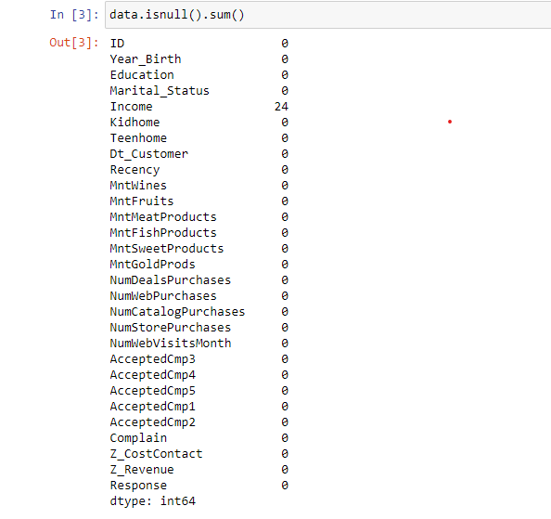

Data Cleaning
This dataset contains 2240 rows and 29 columns
There are 24 missing values in income columns we have to drop that , after removing that missing values now that data set contains 2216 rows and 29 columns
There is no duplicate values in dataset.

Slide 5
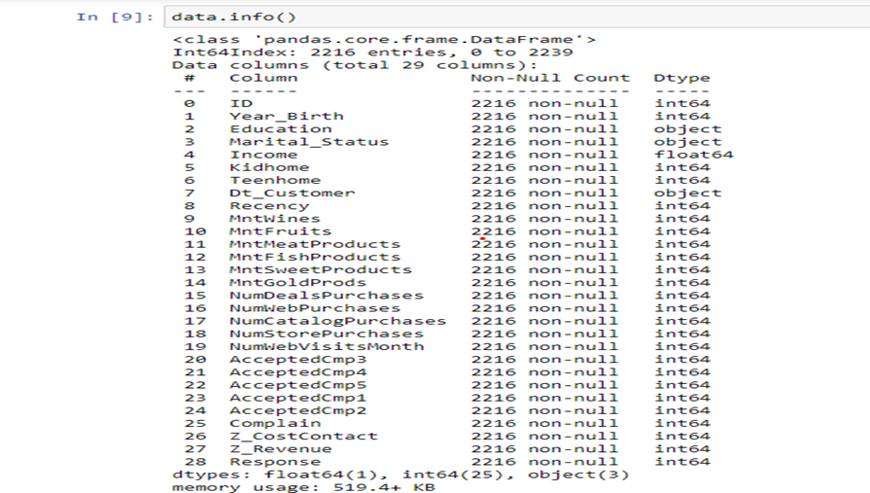
We Ensured that all columns have the correct data types.

Slide 6



Feature Engineering
Extract the "Age" of a customer by the "Year_Birth" indicating the birth year of the respective person.
Create another feature "Spent" indicating the total amount spent by the customer in various categories over the span of two years.
Create another feature "Living_With" out of "Marital_Status" to extract the living situation of couples
Create a feature "Children" to indicate total children in a household that is, kids and teenagers.
To get further clarity of household, Creating feature indicating "Family_Size“
Create a feature "Is_Parent" to indicate parenthood status

Slide 7
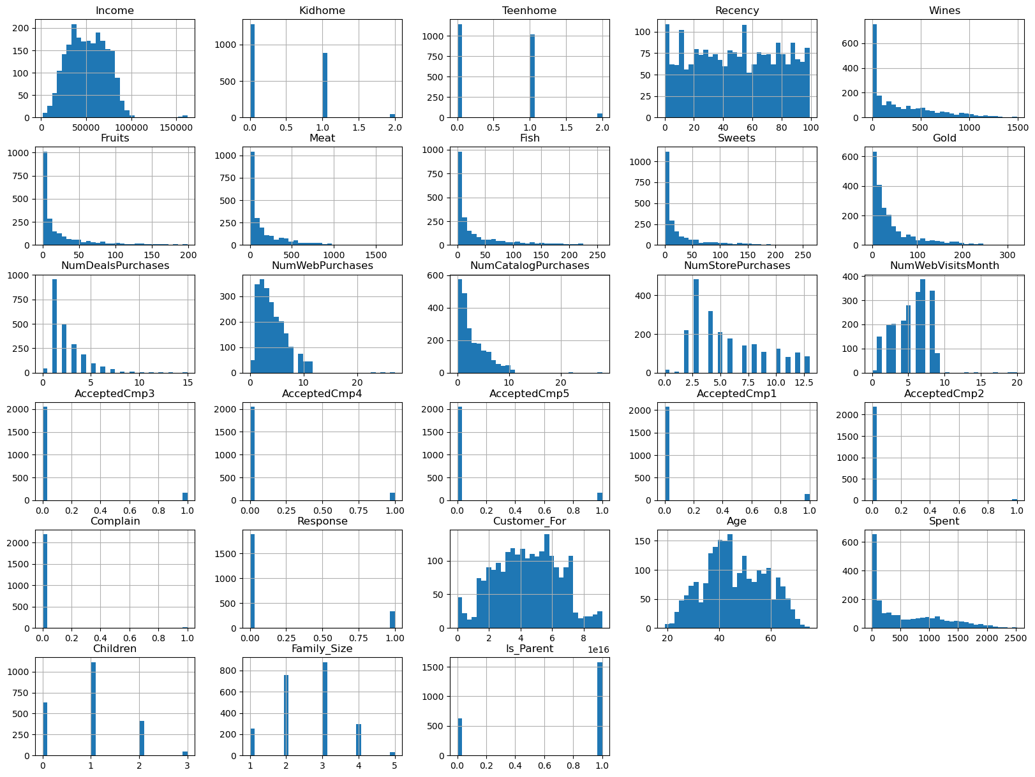
Univariate analysis so we have done the univariate analysis by using histogram

Slide 8
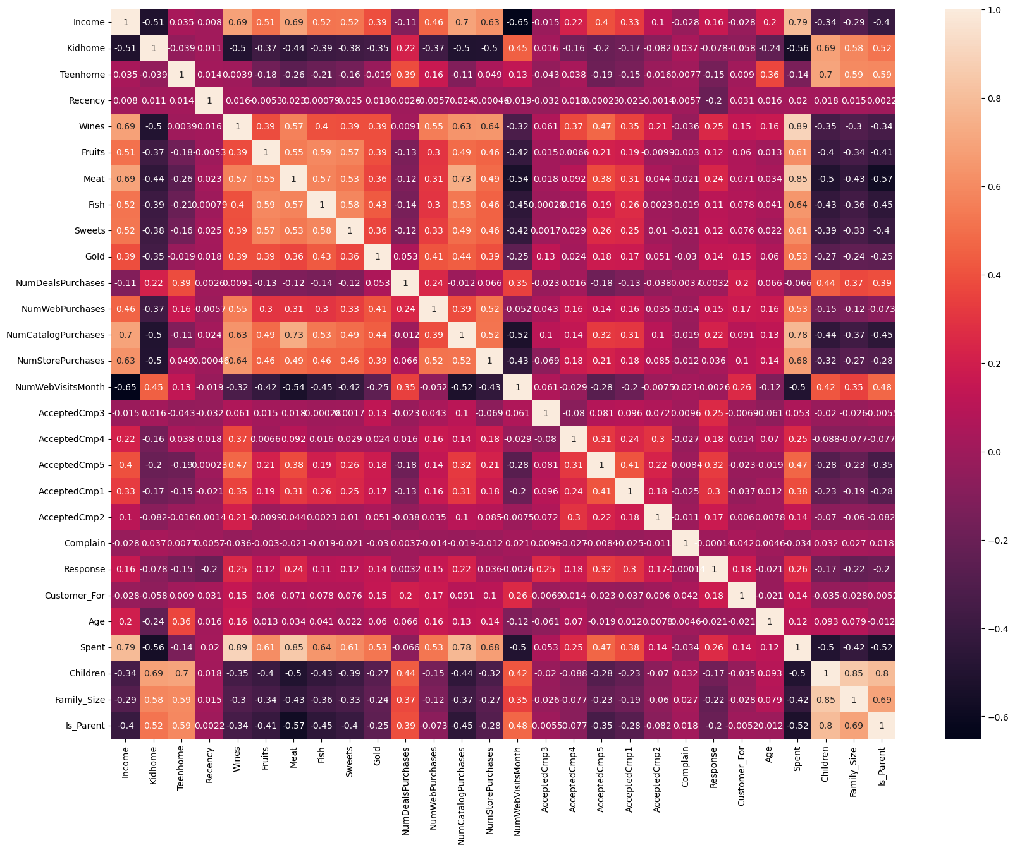
Bivariate analysis
So we have done the bivariate analysis with the help of correlation matrix
High correlation between customer's income and spending. Also high correlation between buying wine, meat and buying through catalog and stores with income and spending.
High correlation between buying meat and buying through catalog.

Slide 9
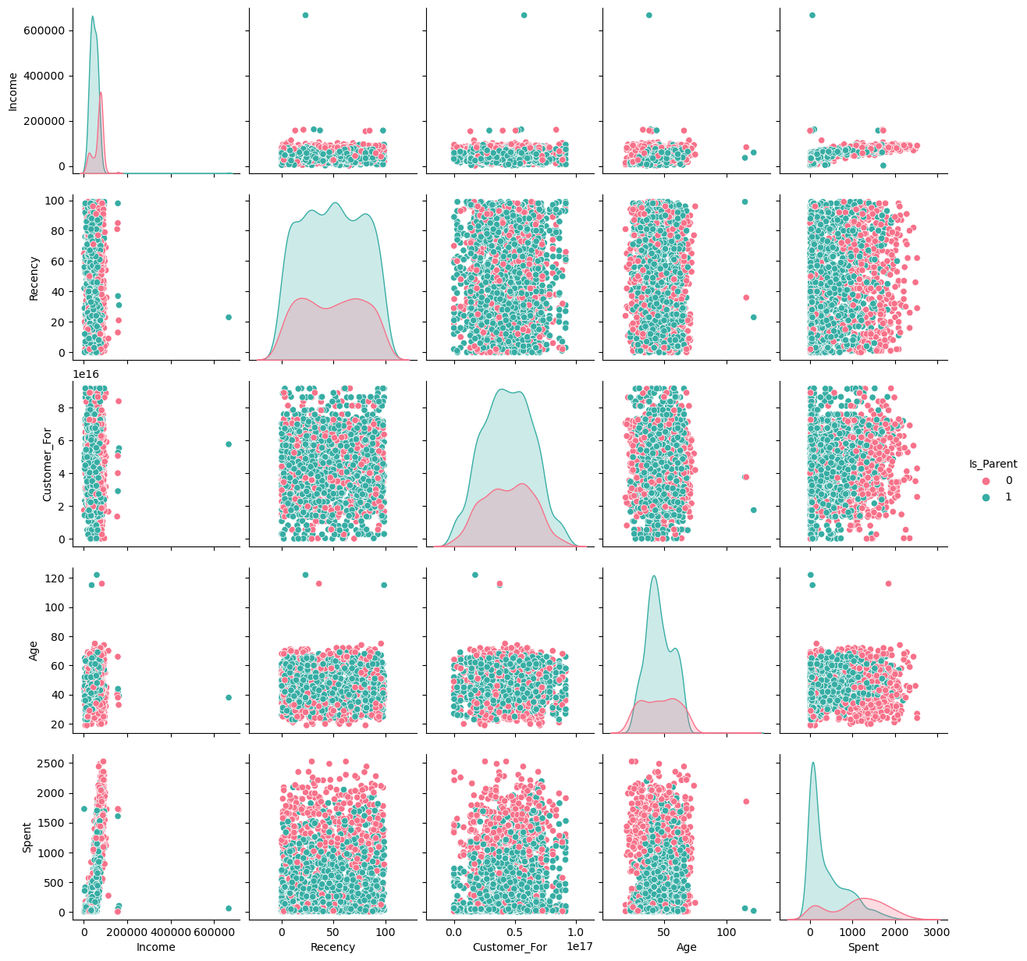
Data analysis and Visualization
Pair plot of some selective features
From this pair plot we can conclude that there are few outliers in the income and age features

Slide 10
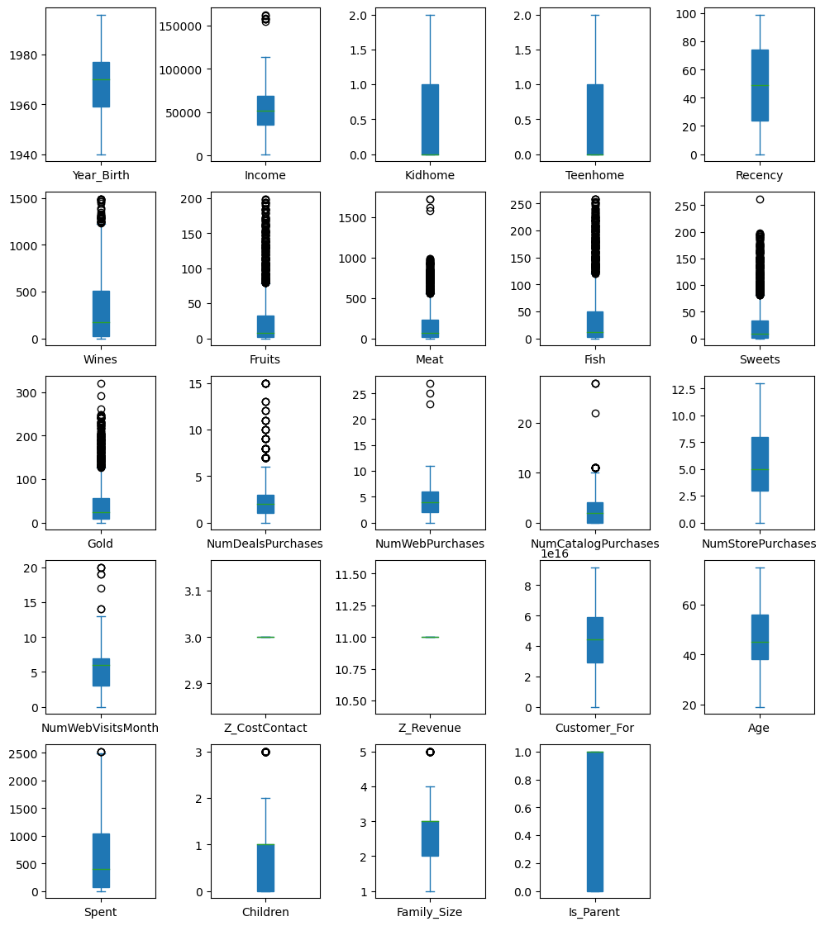
We had also observe the outlier of each features with the help of boxplot

Slide 11
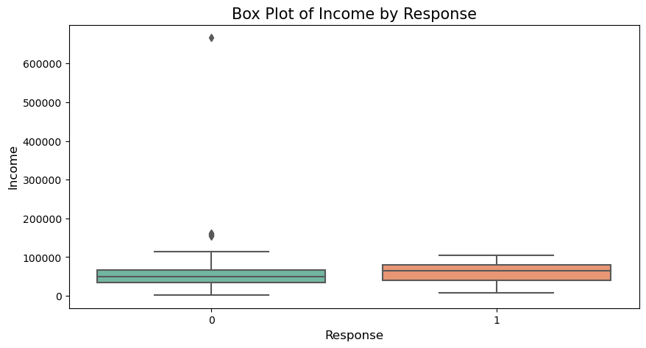
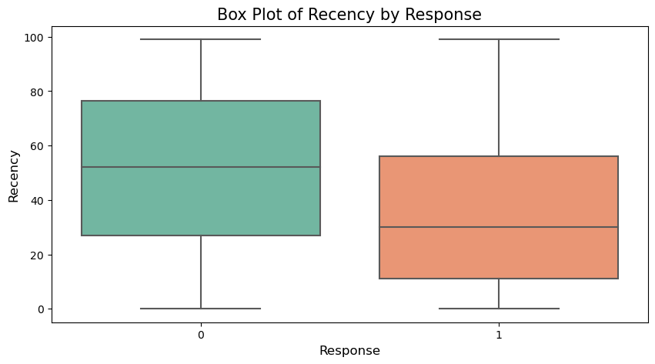
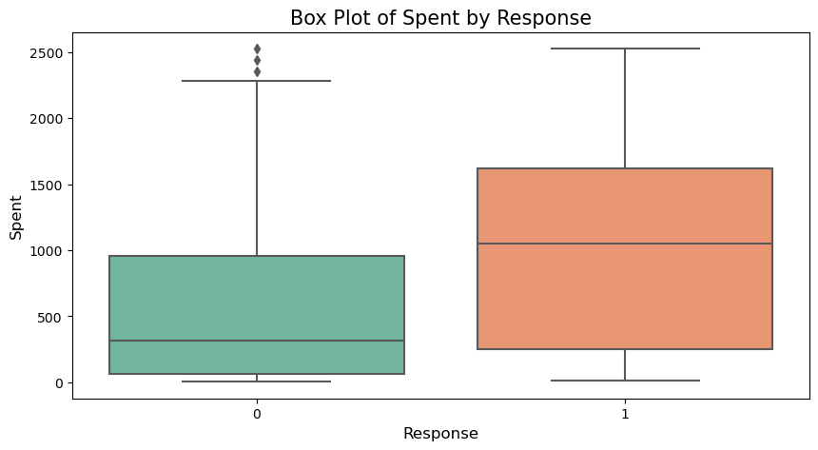
Checking for the outliers with target
Choosing some of the columns to check outliers that is Income, Children, Recency and Spent .
Creating box plots for each main column comparing to the target 'Response'

Slide 12
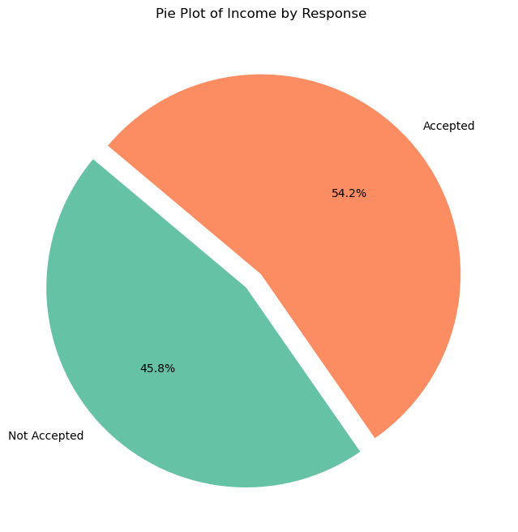
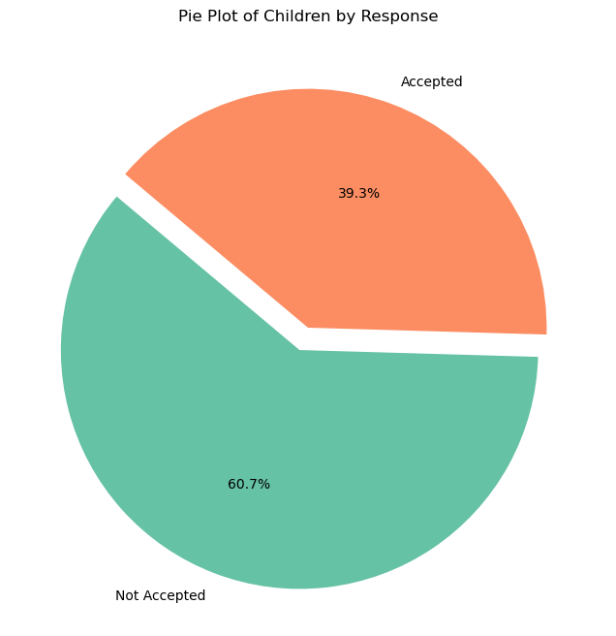
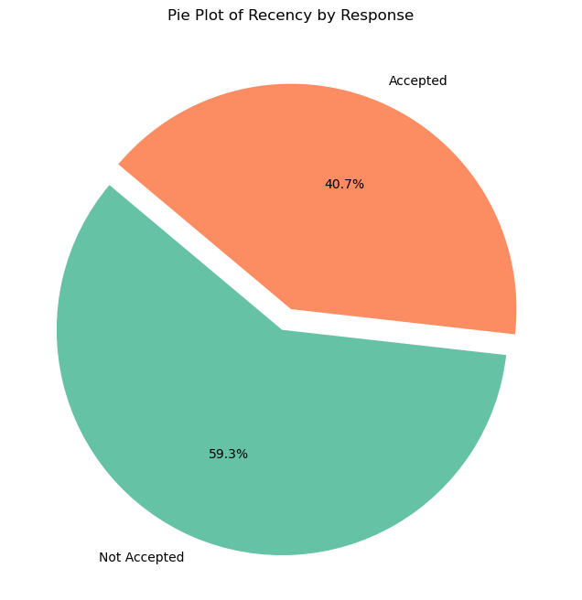
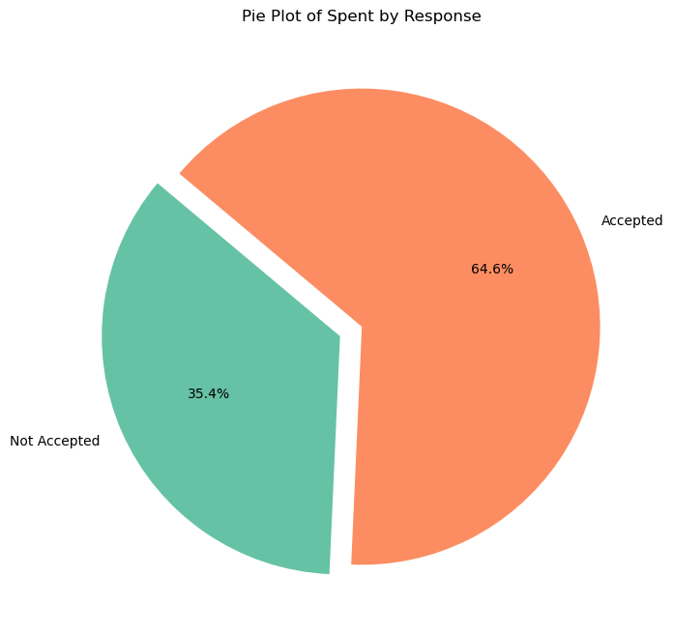
We had created pie plots for each main column compared to the target 'Response’ with the help of pie plot we checked that how much it is effective on data for example pie plot of income by response 54.2% Accepted and 45.8% Not Accepted

Slide 13
Removing of outliers

Slide 14
Next week target :
Feature selection
Feature extraction
Model building

Slide 15
Model Building

Slide 16
Model Building
We have implemented a different algorithms like Logistic Regression, Knn, SVM, Decision tree, Random Forest, XGBoost.
We have compared all the model on their F1 score, Precision and Recall values

Slide 18
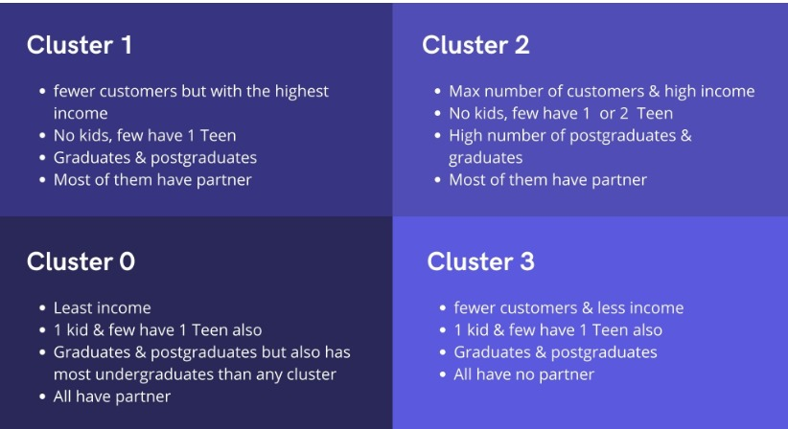
Customer Analysis

Slide 19
Classification and model Building

Slide 20
Comparison of Classification Model

Slide 21
Model Deployment
1. Creation of app file
2.Creating a stream lit link
3.Creating a webpage for inputing data

Slide 22
Web Page Interface

Slide 23
Challenges faced
Eda and data cleaning – handling missing values, detecting and removing outliers.
Feature engineering – adding a new feature and selecting relevant feature for clustering
Clustering – selecting the right algorithm with the help of silhouette score.
Deployment – integrating the model ,ensuring scalability and creating a user friendly interface

